Slide 1
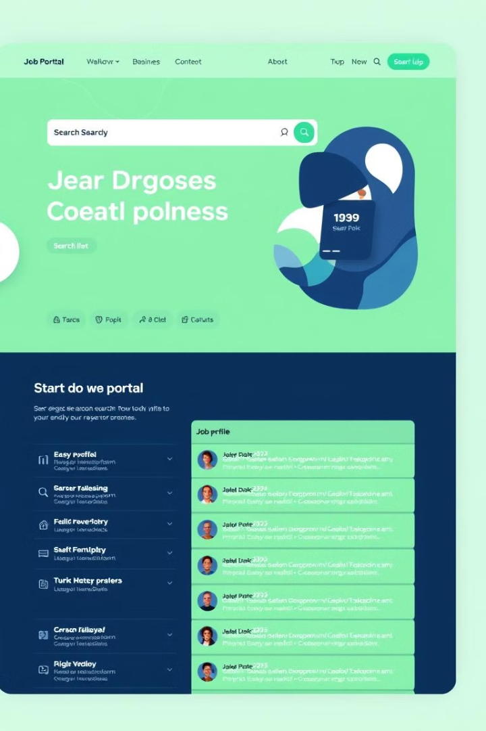
Developing an Online Job Portal for Job Seekers Using Java Applets
The increasing demand for digital job search platforms has created a need for efficient and user-friendly online job portals that bridge the gap between job seekers and employers. This project focuses on developing an online job portal using Java Applets, offering a dynamic and interactive platform for job seekers. The portal facilitates essential functionalities such as user registration, job searching, resume uploading, and job application submission. Java Applets are employed to create a responsive and secure user interface, while Java-based server technologies like Servlets or JSP handle backend processing and database interaction.

Slide 2
Project Overview
1
User Registration
The portal allows users to register by providing basic information such as name, email address, and password. This step ensures a secure and personalized experience for each user.
2
Job Search
Job seekers can search for jobs based on various criteria, including keywords, location, job type, and salary range. The portal offers advanced search filters to refine the search results.
3
Application Submission
Once a job seeker finds a suitable position, they can apply by submitting their resume and a cover letter. The portal facilitates a seamless application process, allowing users to easily submit their applications.
4
Employer Interaction
Employers can post job listings, manage applications, and communicate with potential candidates. The portal provides a secure platform for employers to streamline their recruitment process.

Slide 3
System Architecture
Client-Side Interface
Server-Side Logic
Database Management
The user interface is built using Java Applets, offering a dynamic and interactive experience. Java Applets provide a rich client-side environment, enabling a responsive and engaging user interface.
Java-based server technologies like Servlets or JSP handle backend processing, database interactions, and application logic. These technologies ensure secure and efficient server-side operations.
A database management system (e.g., MySQL) is used to store user profiles, job listings, and application details. The database ensures data integrity and provides a structured storage solution.

Slide 4

Key Features
1
User Registration and Profile Management
Users can create accounts, update their profiles, and manage their job search preferences.
2
Advanced Job Search Filters
Job seekers can refine their search results based on keywords, location, job type, salary range, and other criteria.
3
Resume Uploading and Management
Job seekers can upload their resumes and manage their resume information within the portal.
4
Job Application Submission
The portal provides a streamlined application process, allowing users to submit their applications directly to employers.

Slide 5
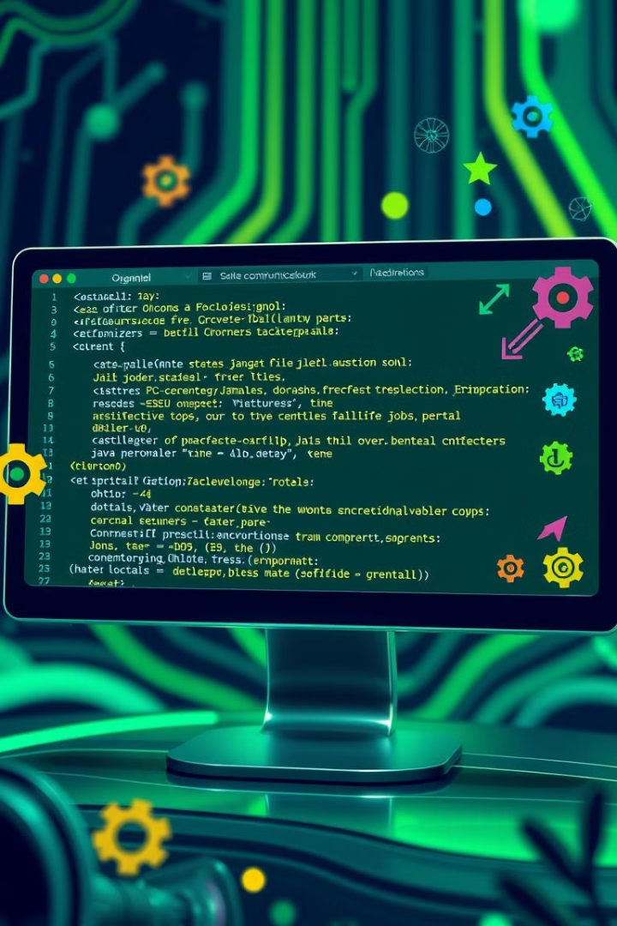
Java Applet Implementation
GUI Design
Java Applets are used to create a visually appealing and user-friendly interface, incorporating elements such as text fields, buttons, and drop-down menus.
Event Handling
Java Applets handle user interactions, such as button clicks and form submissions, ensuring a responsive and interactive user experience.
Network Communication
Java Applets communicate with the server-side components (Servlets or JSP) to retrieve data, process requests, and update the user interface.

Slide 6




Backend Architecture
Server-Side Logic
Database Interaction
Application Processing
Java Servlets or JSP handle server-side requests, process user data, and interact with the database.
The backend interacts with the database to store and retrieve user information, job listings, and application details.
The backend processes job applications, manages user accounts, and ensures data security and integrity.

Slide 7



Security and Scalability
Security
Scalability
The portal incorporates secure authentication and authorization mechanisms to protect user data and ensure data privacy.
The system is designed to handle an increasing number of users and job listings, ensuring a robust and scalable platform.

Slide 8

Conclusion
The development of an Online Job Portal using Java Applets provides an efficient platform for job seekers and employers to connect. This system allows job seekers to search and apply for jobs seamlessly, while employers can post job listings and manage applicants with ease. By leveraging object-oriented design principles, the portal ensures modularity and flexibility, enabling easy updates and scalability.

